Slide 1
Welcome to IDMA
September 20: Second Meeting of the Fall Semester!

Slide 2
Agenda
Introductions (Again)
Guest Speaker Presentation: Kim Nimsgern of Click-N-Curl
Executive Board Campaigns
MnSearch Event Registration
IDMA Executive Board Vote

Slide 3
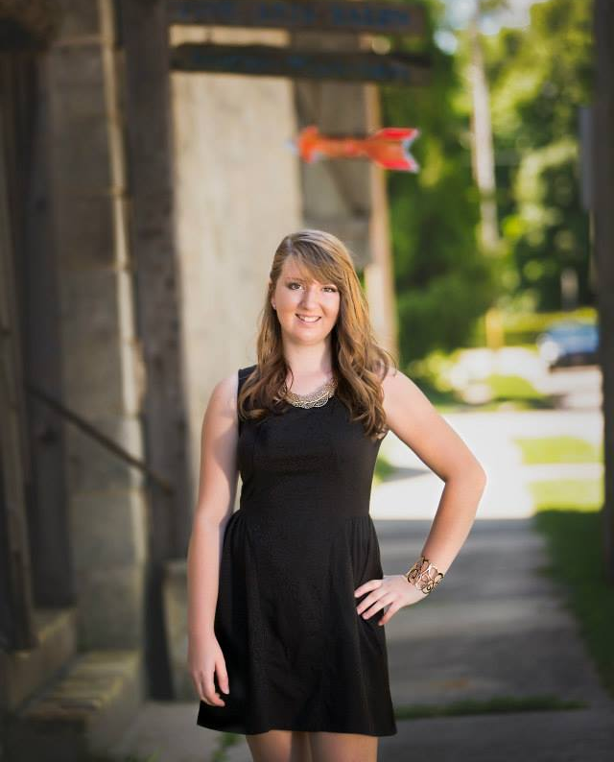
Meet President Kate Travis
Senior w/ Double Major in PCEM & DMT (Graduating 2019)
Favorite Social Media: Facebook, Instagram, YouTube
Hobbies: Blogging, Adventuring, Eating Out with Friends
Ask Me About My Bicycle Gang: The Cruising Losers
Internships/Industry Experiences: 4

Slide 4
Will you be next?
Vice President
Treasurer
Secretary
Film Director

Slide 5
Kim Nimsgern & Deanna Metcalf
To Introduce Our First Hands-On Project!

Slide 6
Product education
https://www.amazon.com/stores/page/E7236574-FAD8-4435-B85E-E8676F9AC3BA
Science of a curl
https://www.youtube.com/watch?v=AddQAPr5ChU

Slide 7
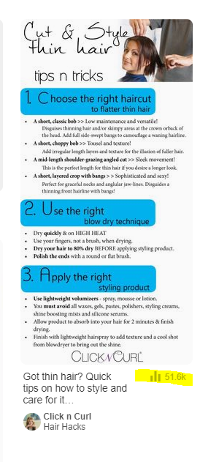
Marketing
https://www.click-n-curl.com/blog/
Taboola
Buzzfeed
Pinterest:

Slide 8
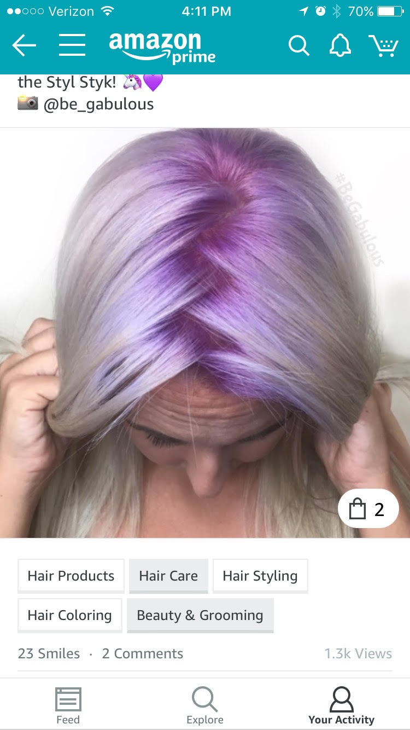
Sponsored Posts
Facebook: https://www.facebook.com/clickncurl/
Instagram: https://www.instagram.com/clickncurl/
Amazon Ads and Spark:

Slide 9
Other Goals
Increased Consumer Education Videos For Website

Slide 10
Main Accounts
US:
Target, WalMart, Kohls, Macy's (.com)
Bed Bath and Beyond
Shaper Image Catalog
Flash sale sites: Jane.com and Zulily.com
The Grommet.com
International:
Taiwan - Citisocial
UK - QVC
Australia
South Africa

Slide 11
Questions?

Slide 12
QUICK POLL
Should IDMA make a Facebook group to communicate with this year’s active members?

Slide 13
Open Exec Board Roles
Vice President
Meet bi-weekly with the organization advisor and president
Work with secretary to coordinate outreach for potential speakers/events
Perform duties of the president in their absence
Work with other executives on creation and posting of all social media and public relations initiatives
Create all marketing materials for promotion of organization
Responsible for completing the officer agreement form in September of each year

Slide 14
Vice President Campaigns
Lauren Yocum

Slide 15
Open Exec Board Roles
Treasurer
Perform the duties of the president if both the president and vice president are absent
Establish and keep record of funds in organization’s bank account
Organize, collect and deposit member dues into organization’s bank account
Get estimates of the cost for all trips, speakers, and other paid organization activities
Work with other executives on creation and posting of all social media and public relations initiatives
Collaborate with other executives in coordinating next year’s election schedule
Responsible for completing the officer agreement form in September of each year
Submit budget requests to the Financial Affairs Committee of the Stout Student Association as needed

Slide 16
Treasurer Campaigns
Stephanie Zengler

Slide 17
Stephanie ZeNgler
For Treasurer

Slide 18
About stephanie
Junior studying Business Administration with a minor in Communication Studies
Experience taking Economics and Accounting classes
Experience in Managing Budgets:
Have served on the Financial Affairs Committee (of the Stout Student Association) for almost two years
General Member
Vice Chair
Currently serving as the Director

Slide 19
Why I’m interested in the position of treasurer
Really excited to improve the sustainability of IDMA for future fiscal years
Utilizing budget experience
Better serving Student Organizations

Slide 20
Thank you!

Slide 21
Open Exec Board Roles
Secretary
Send alerts of meeting time and location to all members twenty-four hours in advance of any meetings.
Take and keep record of membership and attendance
Record and distribute meeting minutes to all members
Record and file all motions, recommendations and election results
Give written notice to members that have accumulated two absences
Work with the vice president to publicize and announce elections of executive board position
Maintain and keep updated OrgSync page
Check and respond to all emails
Work with other executives on creation and posting of all social media and public relations initiatives
Coordinate the next year’s election schedule in consultation with the other members of the executive board.
Manage the organization email account

Slide 22
Secretary Campaigns
Amora Dolan

Slide 23
Open Exec Board Roles
Film Director
Supervise and direct the creation of new videos on industry topics every other Tuesday. The purpose of these videos shall be:
To provide students with updates on industry trends
To offer resources to students interested in digital marketing
To assist the Innovative Digital Marketing Association at UW-Stout with achieving brand recognition and awareness for recruitment
Manage the creation of videos to promote our organization
Work with other executives on creation and posting of all social media and public relations initiatives
Review and track the analytics on our published videos to identify areas for improvement
Coordinate interviews with relevant people and industry professionals for videos

Slide 24
Film Director Campaigns
Kelsey Soderberg

Slide 25
First Event Next Week
MnSearch
Optimizing Yourself: A Practical Career Development Panel
Wednesday, September 27th 6:00 pm
Minneapolis, MN
We will be leaving from Comm Tech 236 at 4:45 pm on that day, and returning around 9:30 pm.
If you’re interested in attending this event, please email idma@uwstout.edu ASAP!

Slide 26
Now . . .
WE VOTE!

Slide 27
Executive Board Meeting (Improptu)
Officer Agreements
Leadership Summit (6-9 pm on Monday, September 25)
Attend to Spend
Schedule Meeting Times

