Slide 1
Welcome to IDMA
October 18: Fifth General Meeting of the Fall Semester!

Slide 2
Agenda
Introductions
Click n Curl Q&A/Proposal– Kim Nimsgern
October Event
Budget Review
MnSearch Registration
Mascot Naming Ceremony

Slide 3
Introductions

Slide 5
October event
Networking Panel & Workshop
Monday, October 30 6 pm–8 pm, MSC Ballroom C
Featuring Industry Professionals From
Thomson Reuters, Collegis Education, Click n Curl and Royal Credit Union
Food:
Veggie Tray, Taco Dip & Tostadas, Cookies, Ice Water

Slide 6
October event
Any volunteers to promote the event on social media next week?
Any volunteers to table with the mascot next week and pass out Halloween candy and event promotions?

Slide 7
IDMA Contingency 1 Budget
IDMA Buttons & Stickers Reimbursement
Future Promotional Items? (300 1.25” Buttons, 100 Pens, 100 Cups, Mascot Head)
Domain & Hosting
Gas Reimbursement & Parking
Food for Recruitment Event/Education or Cultural Event
Hand-written Thank You Letters for Partners
$190.00
$229.00
$128.29
$916.80
$145.00
$15.00
$1624.09

Slide 8
MNSearch Event
MnSearch
Driving Your Business Forward with Testing & CRO
Wednesday, October 25th 6 – 8 pm
Minneapolis, MN
Carpool will leave campus at 4:00 pm from Communication Technologies 236
If you plan to drive, you will need to fill out the online driver authorization form.
If you’re interested in attending this event, please email idma@uwstout.edu by Friday at noon!

Slide 9
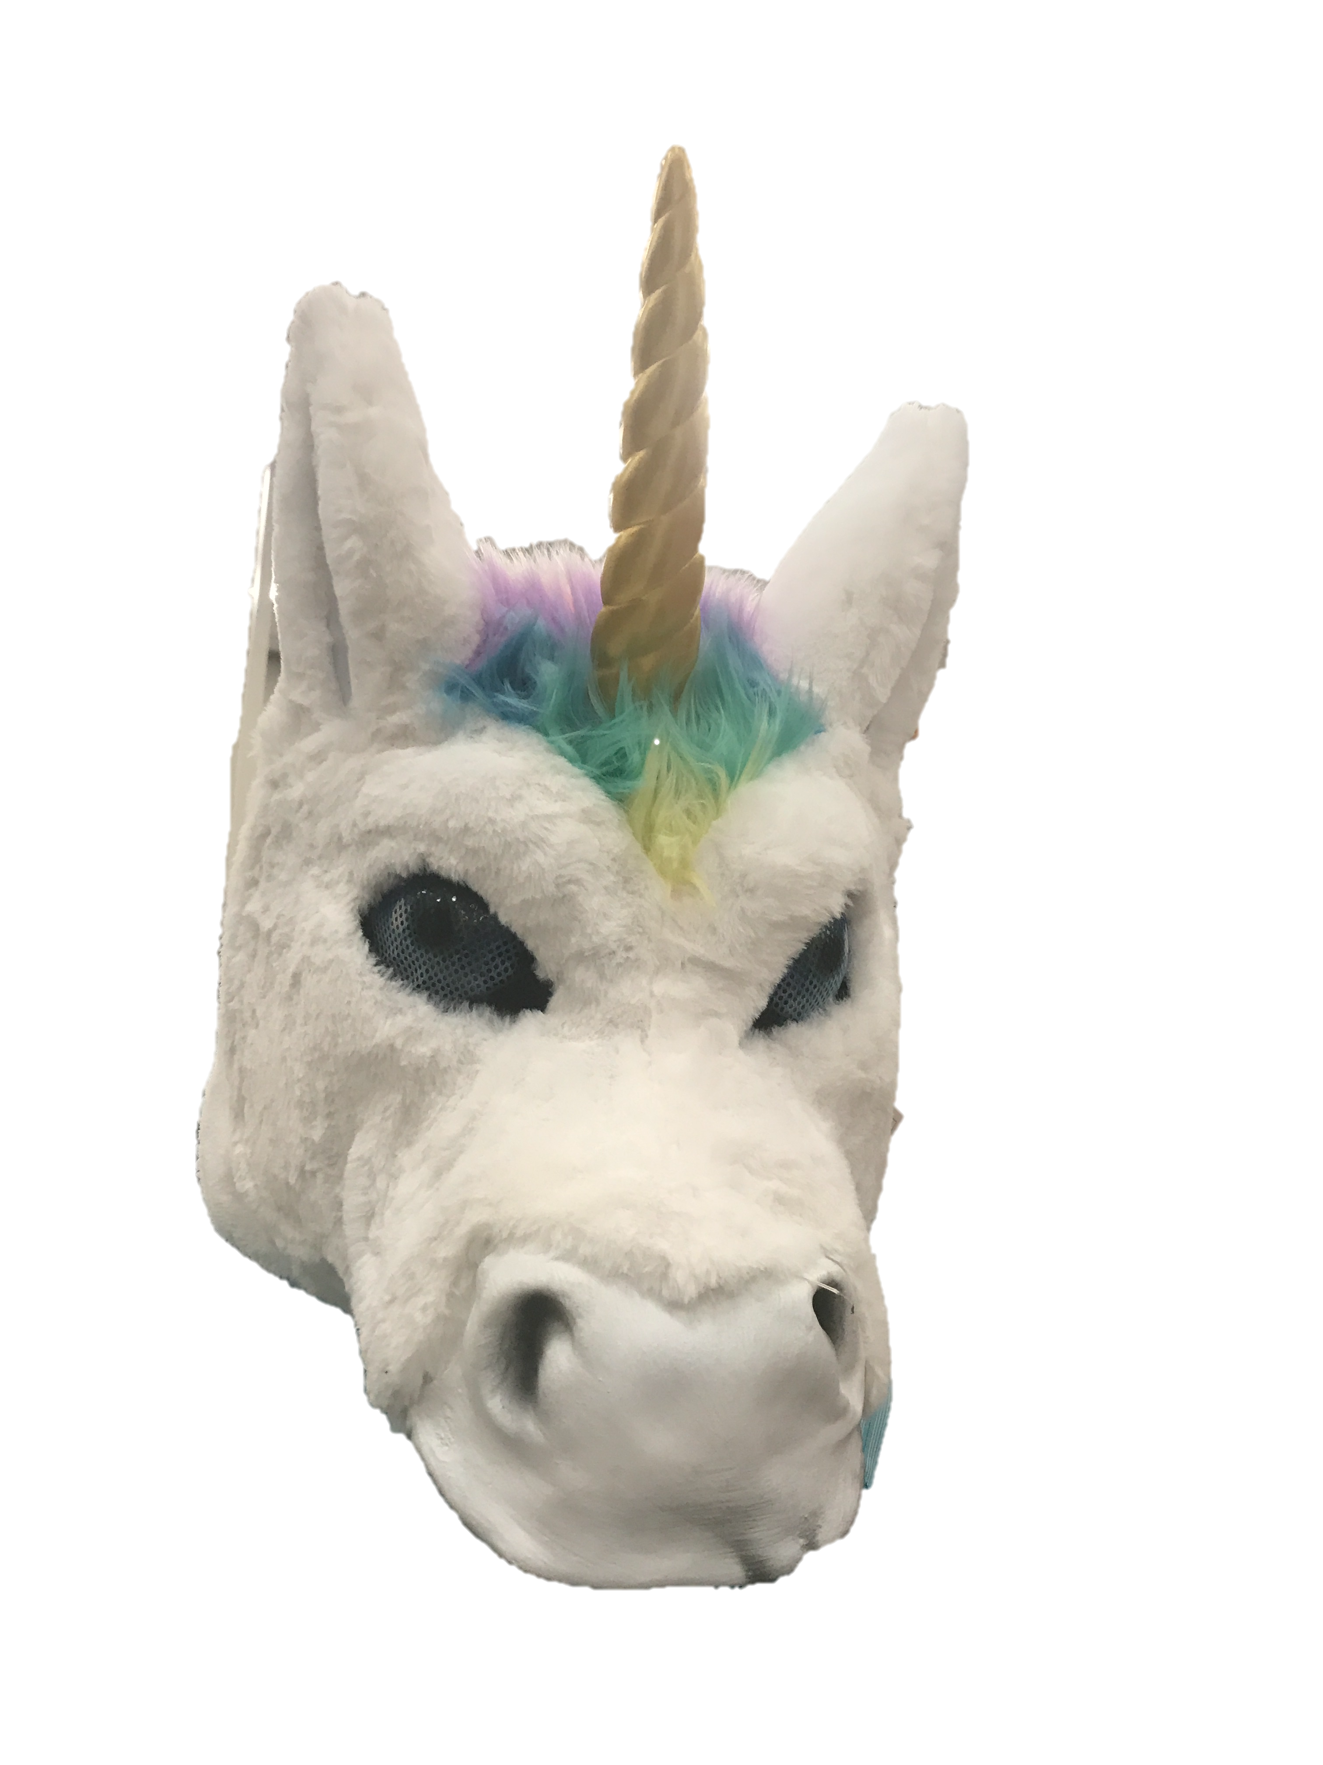
Introducing ___________?
What should we name our new mascot?

Slide 10
THANK YOU!

