Slide 1
SHRM 2022 BOARD ELECTIONS
SOCIETY OF HUMAN RESOURCE MANAGEMENT

Slide 2
ABOUT
New board positions need to be filled for the Fall of 2022! This presentation will go through the descriptions of each position.
If you are interested, please attend our Teams meeting on March 8th at 7:00 PM. A link will be provided beforehand. This meeting will be a time to learn more about the position by talking to our current board members and asking them questions.
Email shrm@uwstout.edu for more questions!

Slide 3
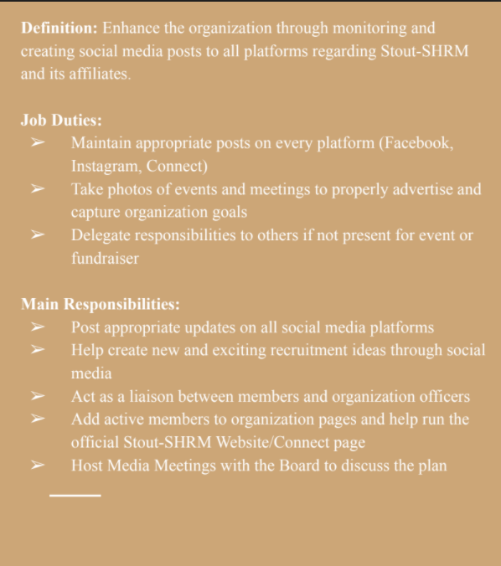
PUBLIC RELATIONS SPECIALIST
Feel free to contact our current Public Relations Specialist, Allison Maroszek: maroszeka6582@my.uwstout.edu

Slide 4
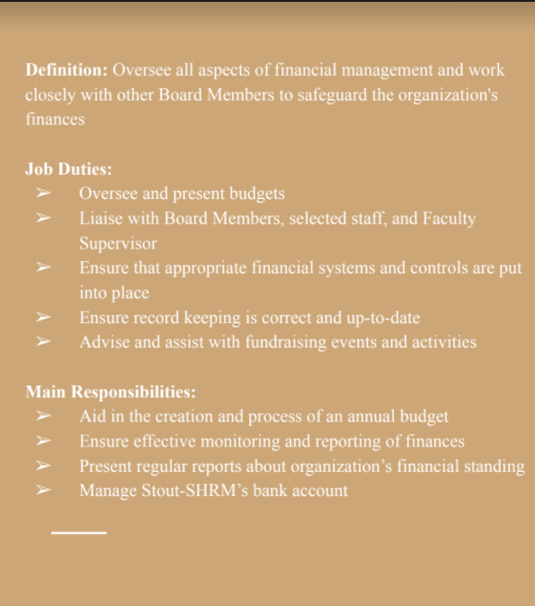
TREASURER
Feel free to contact our current Treasurer, Sidd Tiwari: tiwaris4088@my.uwstout.edu

Slide 5
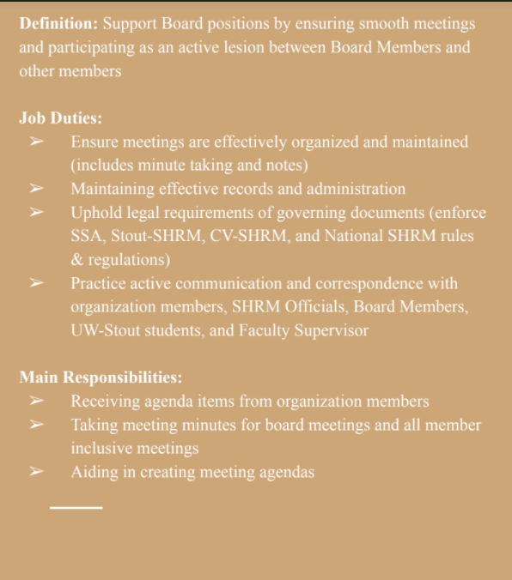
SECRETARY
Feel free to contact our current Treasurer, Kyle Scheuers: scheuersk8618@my.uwstout.edu

Slide 6
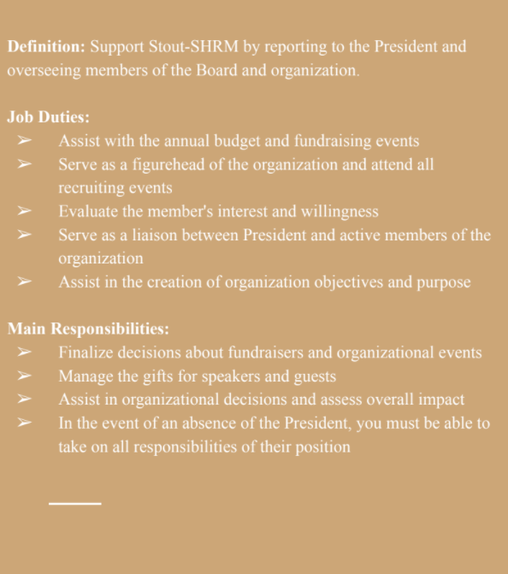
VICE PRESIDENT
Feel free to contact our current Treasurer, Dylan LaFontaine: lafontained6985@my.uwstout.edu

Slide 7
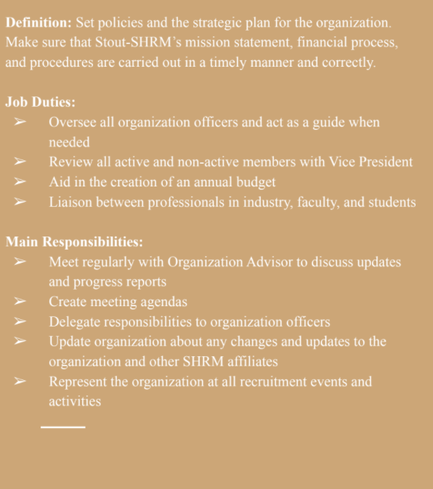
PRESIDENT
Feel free to contact our current Treasurer, Emma Levendowski: levendowskie9031@my.uwstout.edu

Slide 8
MORE INFORMATION
Being a board member in an organization is great to add to a resume and share with any employer. Along with the leadership skills you gain, you build new relationships and friendships with everyone you meet. This is a great opportunity for all students!
Do not be afraid to reach out to any board members for information on these roles.

