Slide 1
Welcome to IDMA
October 11: Fourth General Meeting of the Fall Semester!

Slide 2
Agenda
Introductions
Project/Skype4Business Etiquette
October Event
Ideas for IDMA Budget
Click-N-Curl Planning & Strategy

Slide 3
Introductions

Slide 4
Project Etiquette
Every general meeting will be teleconference-friendly to support CI students
Link is posted on Social Media & OrgSync
Anyone could be in attendance!
So:
Keep criticism constructive
Treat every conversation as if our partners, professors, etc. are in the room!

Slide 5
October event
Networking Panel & Workshop
Monday, October 30 6 pm–8 pm, MSC Ballroom C
Featuring Industry Professionals From
Thomson Reuters, Collegis Education, and Royal Credit Union

Slide 6
October event
Food?
What would be appropriate snacks or food to have at the event?

Slide 7
IDMA Contingency Budget
IDMA Buttons & Stickers Reimbursement
Future Promotional Items? (Buttons (1-inch), Pens, Cups, Stuffed Unicorn, Mascot Head, Fleet Feet Baseball Hats)
Domain & Hosting
Gas Reimbursement
Food for Recruitment Event/Education or Cultural Event
$190
?
?
?
?

Slide 8
IDMA Contingency Budget
Mascot Head????

Slide 10
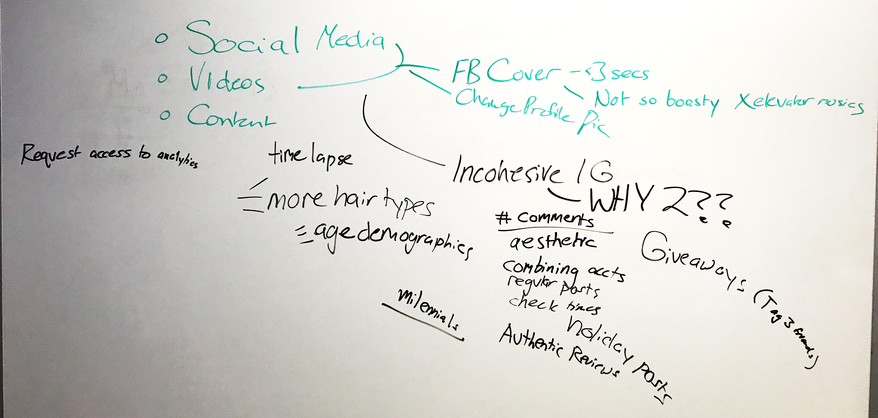

Slide 11
THANK YOU!

