Slide 1
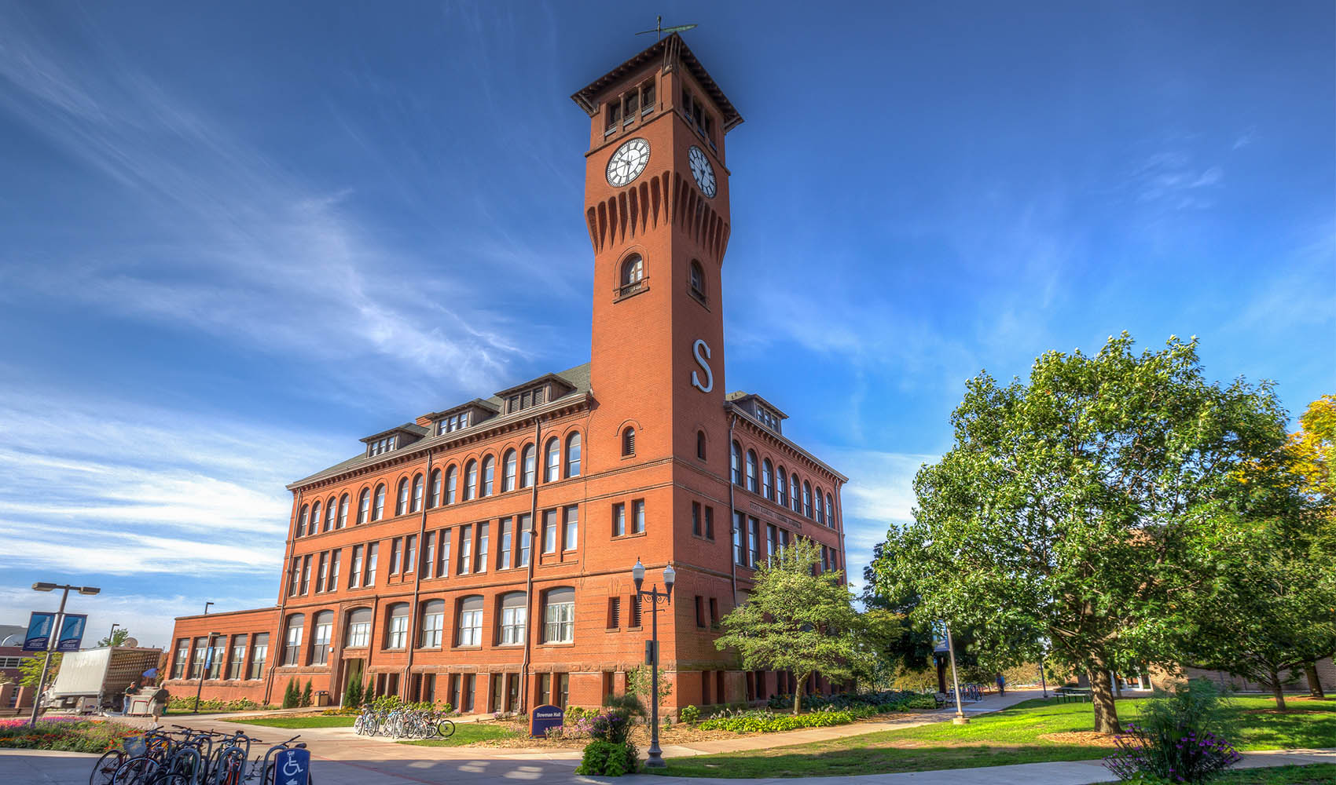
Information Technology
SSA Update
March 2020
Sue Traxler
FOCUS 2020 Inspiring Innovation. Learn more at www.uwstout.edu
Current Date

Slide 2
IT Update
Duo 2-Step
Some student rollout 2nd half Spring term
First year students Summer 2020
Remaining students Fall 2020
Testing Print Management and Print Release Summer/Fall
Software Procurement Academic Procedure
Adobe Licensing – re-enroll every 6 months
Pandemic Planning
TITLE
Current Date
FOCUS 2020 Inspiring Innovation. Learn more at www.uwstout.edu

Slide 3
Software Procurement
Engage LIT Staff at beginning of exploring/purchasing software.
LIT security staff will review the software request for compliance and potentially develop a solution to allow the software to work for our campus. At minimum, the following areas will be reviewed for compliance.
a. Data Classification: High, Medium or Low risk
b. Authentication Requirements: Password and account login requirements
c. Data Protections: How the data is encrypted
d. Data Retention: How the data is either retained or removed
e. Data Privacy: FERPA, PCI, GDPR and intellectual property
TITLE
Current Date
FOCUS 2020 Inspiring Innovation. Learn more at www.uwstout.edu

Slide 4
Questions?
TITLE
Current Date
FOCUS 2020 Inspiring Innovation. Learn more at www.uwstout.edu

