Slide 1
Spikeball Club
1 Year Plan

Slide 2
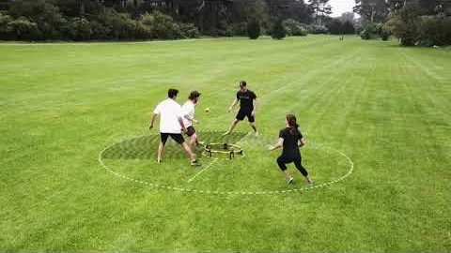
What is Spikeball Club?
What is Spikeball?
The Spikeball Club is designed to be a safe and fun place for people to learn about and play Spikeball regularly on campus

Slide 3
1 Year Plan
Now:
Get approved by SSA!!!
Recruit members and gage interest in pick-up games, leagues, and tournaments
Beginning Spring Semester 2021:
Begin weekly pick-up games
Advertise and spread the word to recruit more people
Gage interest in pick-up games, leagues, and tournaments
When outdoor play is possible:
Switch from indoor to outdoor games
Continue the pick-up games or start a league if interest is high enough
Host a tournament as soon as it is warm enough and snow has melted (late March, early April)
Host another tournament sometime in May

Slide 4
1 Year Plan continued
Fall Semester 2021
Recruit several new players, ideally freshmen
Host a weekly league
Continue weekly pick-up games
Host two outdoor tournaments before weather is too cold
Host one indoor tournament
Long term
Continue hosting leagues, pick-up games, and tournaments
Participate in tournaments in Minneapolis, Madison, and elsewhere in the Midwest

